Slide 1
Definisi dan Siklus Manajemen Proyek

Slide 2
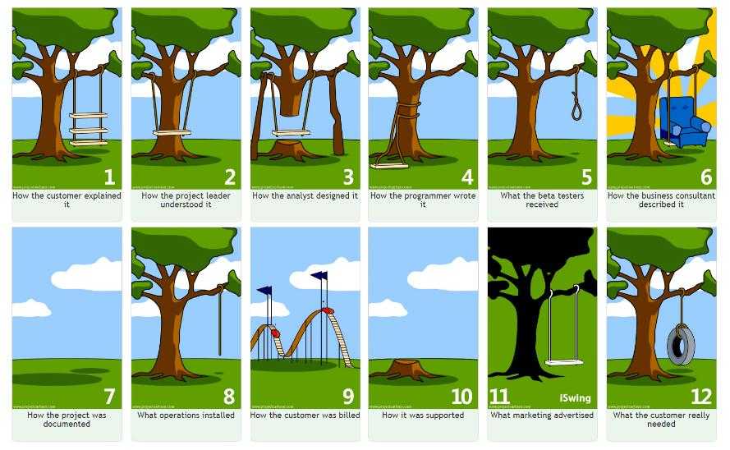
Project Management Tree Swing Analogy

Slide 3
Apa itu Manajemen?

Slide 4
Manajemen Sebagai Seni
Seni untuk merealisasikan pekerjaan melalui orang lain
  Seni memimpin
  Seni berkomunikasi
  Seni memotivasi dan mempengaruhi
  Dll
Lebih ke arah kemampuan dan keterampilan pribadi (manajer)

Slide 5
Fungsi Manajemen
Perencanaan
Organisasi
Koordinasi
Pengendalian
Pengarahan

Slide 6
Definisi Manajemen
Manajemen adalah proses merencanakan, mengorganisasikan, memimpin, mengendalikan usaha-usaha anggota organisasi dan proses penggunaan sumber daya organisasi untuk mencapai tujuan organisasi yang telah ditetapkan ( Stoner & Wankel)

Slide 7
Definisi Proyek
Proyek adalah suatu usaha sementara yang dilaksanakan untuk menghasilkan suatu produk atau jasa yang unik (PMBOK).
Ciri-ciri proyek:
  Bertujuan menghasilkan lingkup tertentu berupa produk akhir atau jasa
  Terdapat penentuan biaya, jadwal, kualitas, SDM
  Bersifat sementara, titik awal dan akhir jelas
  Tidak berulang
Bentuk Pengerjaan Proyek:
  Swakelola
  Sub-kontrak

Slide 8
Project Results
A product that can be either a component of another item, an enhancement of an item, or an end item in itself;
A service or a capability to perform a service (e.g., a business function that supports production or distribution);
An improvement in the existing product or service lines (e.g., A Six Sigma project undertaken to reduce defects); or
A result, such as an outcome or document (e.g., a research project that develops knowledge that can be used to determine whether a trend exists or a new process will benefit society).

Slide 9
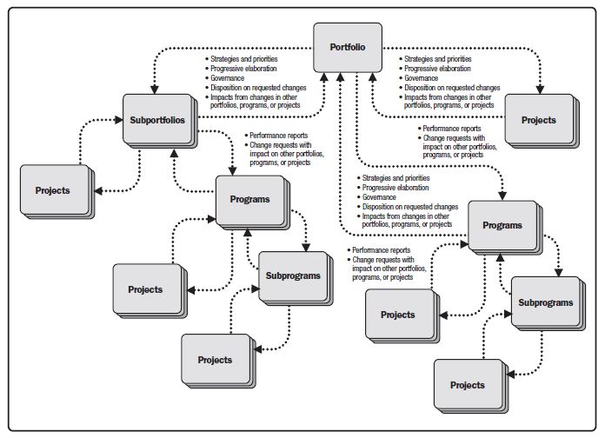
Portfolio, Program, and Project Management Interactions

Slide 10
Life Cycle IT Project
Discovery phase
Concept phase
Design phase
Execution phase
Quality assurance phase
Implementation phase
Closure phase

Slide 11
Penyebab Timbulnya Proyek
Rencana pemerintah
Permintaan pasar
Kebutuhan internal organisasi
Kegiatan R&D untuk inovasi

Slide 12
Faktor Keberhasilan Proyek
Proyek dikelola melalui mekanisme life-cycle project
Melakukan monitoring dan pengontrolan terhadap jadwal, anggaran, kualitas, dan resiko proyek
Memadukan tools dan metode manajemen proyek untuk meningkatkan produktivitas
Komitmen manajemen

Slide 13
Definisi Manajemen Proyek
PMBOK
  Project management is the application of knowledge, skills, tools and techniques to project activities to meet project requirements.
PRINCE2
  The planning, monitoring and control of all aspects of the project and the motivation of all those involved in it to achieve the project objectives on time and to specified cost, quality and performance.
DIN 6991
  Project management is the complete set of tasks, techniques, tools applied during project execution.

Slide 14
Proses Manajemen Proyek
Project management is accomplished through the appropriate application and integration of the 47 logically grouped project management processes, which are categorized into five Process Groups.

Slide 15
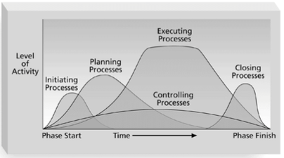
5 Kelompok Proses Manajemen Proyek

Slide 16
Processes and Procedures for Conducting project
Initiating and Planning:
  Guidelines and criteria for tailoring the organization’s set of standard processes and procedures to satisfy the specific needs of the project;
  Specific organizational standards such as policies, product and project life cycles, and quality policies and procedures
  Templates (e.g., risk register, work breakdown structure, project schedule network diagram, and contract templates).

Slide 17
Processes and Procedures for Conducting project (2)
Executing, Monitoring and Controlling:
  Change control procedures
  Financial controls procedures
  Issue and defect management procedures
  Organizational communication requirements
  Procedures for prioritizing, approving, and issuing work authorizations
  Risk control procedures
  Standardized guidelines, work instructions, proposal evaluation criteria, and performance measurement criteria.

Slide 18
Processes and Procedures for Conducting project (3)
Closing
  Project closure guidelines or requirements (e.g., lessons learned, final project audits, project evaluations, product validations, and acceptance criteria).

Slide 19
Pengelolaan Proyek
Identifying requirements;
Addressing the various needs, concerns, and expectations of the stakeholders in planning and executing the project;
Setting up, maintaining, and carrying out communications among stakeholders that are active, effective, and collaborative in nature;
Managing stakeholders towards meeting project requirements and creating project deliverables;
Balancing the competing project constraints
  Scope,
  Quality,
  Schedule,
  Budget,
  Resources, and
  Risks.

Slide 20
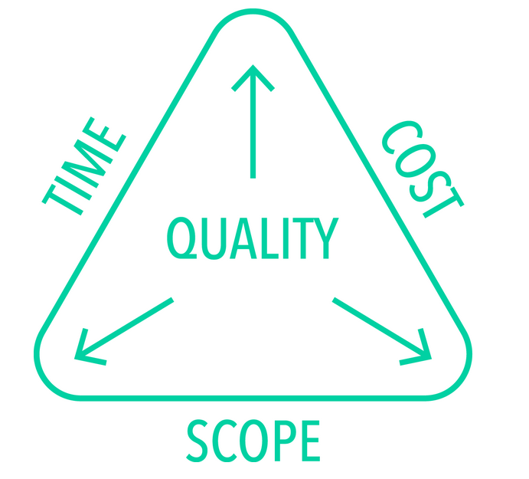
Segitiga Manajemen Proyek

Slide 21
PENGARUH ORGANISASI PADA MANAJEMEN PROYEK

Slide 22
Organizational Cultures and Styles
Organizations are systematic arrangements of entities (persons and/or departments) aimed at accomplishing a purpose, which may involve undertaking projects.
An organization’s culture and style affect how it conducts projects.
Cultures and styles are group phenomena known as cultural norms, which develop over time.
The norms include established approaches to initiating and planning projects, the means considered acceptable for getting the work done, and recognized authorities who make or influence decisions.

Slide 23
Organizational Communications
Project management success in an organization is highly dependent on an effective organizational communication Style.
Organizational communications capabilities have great influence on how projects are conducted
Project managers in distant locations are able to more effectively communicate with all relevant stakeholders within the organizational structure to facilitate decision making.
Stakeholders and project team members can also use electronic communications to communicate with the project manager formally or informally.

Slide 24
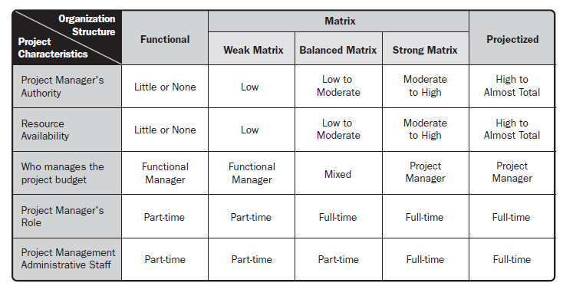
Influence of Organizational Structures on Projects

Slide 25
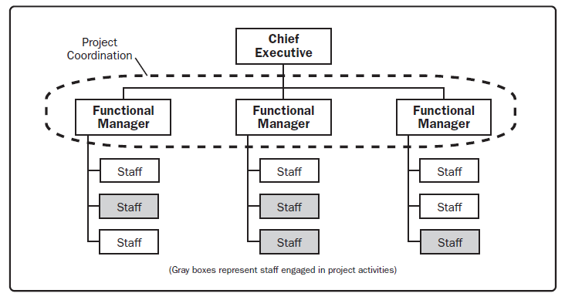
Functional Organization

Slide 26
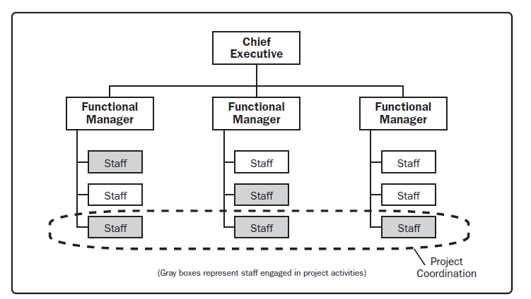
Weak Matrix Organization

Slide 27
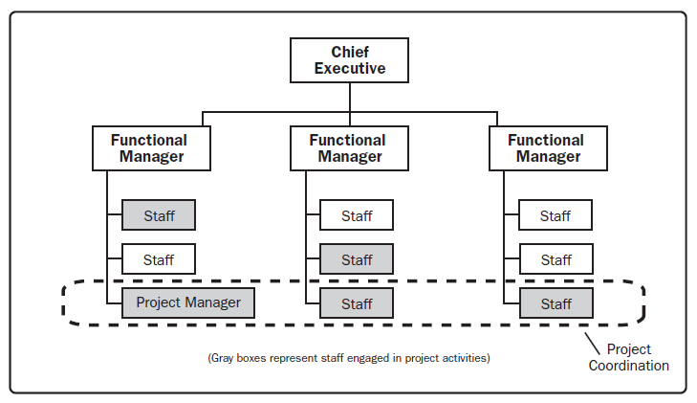
Balanced Matrix Organization

Slide 28
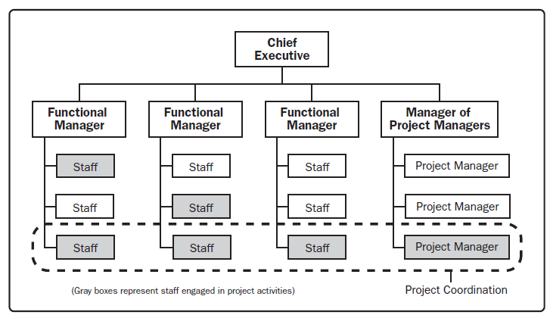
Strong Matrix Organization

Slide 29
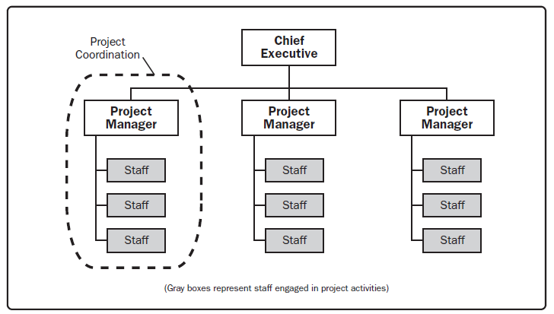
Projectized Organization

Slide 30
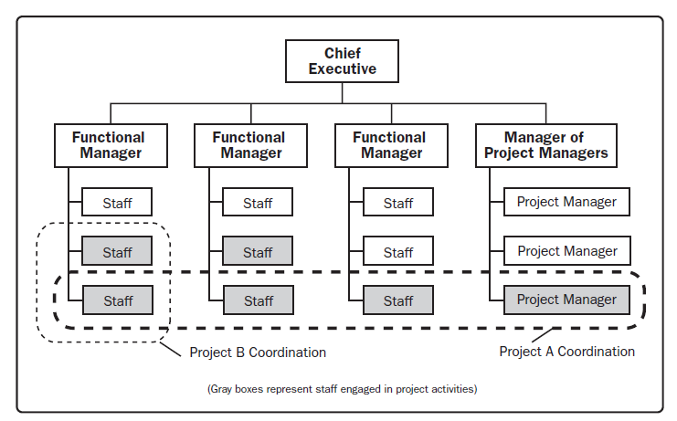
Composite Organization

Slide 31
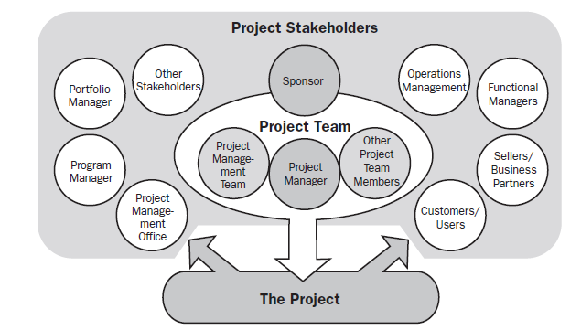
Project Stakeholders

Slide 32
Project Team
Project Manager
Project management staff
Project staff
Supporting experts
User or Customer Representatives
Sellers
Business partner members
Business partners

Slide 33
A life of Project Manager

Slide 34
Successful Project Manager
Are skilled at planning, monitoring, and controlling all aspects of a project and motivating all those involved to achieve the project objectives on time and on budge t, within quality and performance specifications

Slide 35
Successful Project Manager
Leadership
Organization
Communication
Finance
Technical savvy
Politicking
Team Building
Praising/Coaching

Slide 36
IT Project Manager
IT project managers are responsible for planning, organizing, allocating resources for, budgeting, and successfully executing organizations’ specific IT goals. Such projects might include:
  Software and app development
  Hardware installations
  Network upgrades
  Cloud computing and virtualization rollouts
  Projects around business analytics and data management
  Miscellaneous IT services

Slide 37
IT Project Manager Challenges
Changing or unclear client priorities
Unforeseen relationships among hardware, software, networks, and data
Technological updates and advancements that occur in the middle of the project
Infrastructure changes that impact data security and management

Slide 38
Project Life Cycle
A project life cycle is the series of phases that a project passes through from its initiation to its closure.
The phases are generally sequential, and their names and numbers are determined by the management and control needs of the organization or organizations involved in the project, the nature of the project itself, and its area of application.
The phases can be broken down by functional or partial objectives, intermediate results or deliverables, specific milestones within the overall scope of work, or financial availability.

Slide 39
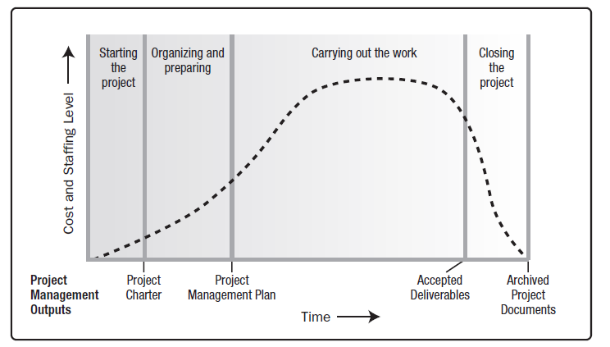
Generic Project Life Cycle Structure

